Slide 1
Order-free Medicine Combination Prediction with Graph
Convolutional Reinforcement Learning
ADVISOR: JIA-LING, KOH
SOURCE: CIKM ’19
SPEAKER: kuan-yu, sheng
DATE: 2020/04/13

Slide 2
Outline
Introduction
Method
Experiment
Conclusion

Slide 3
Introduction
3
Medicine Combination Prediction :
Procedure
CompNet
Medicine Combination
Diagnosis

Slide 4
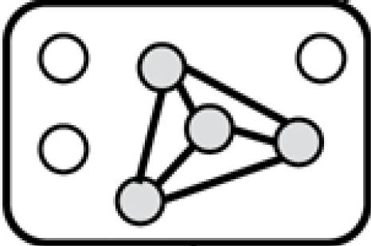
Introduction
4
A sequence of ICD-9 code
Example: { “1125”, “v433”, “v4581” }
Procedure
Chosen Medicine
A sequence of ICD-9 code
Example: {“0066”, “3761”, “3950” }
Diagnosis
Medicine not chosen
Graph like representation :
Medicine Combination

Slide 5
Introduction
5
Problem :
The correlations between medicine.
Classification problem : Ignore correlations between medicines .
Sequence prediction problem : There’s no orders among medicines in reality.
The adverse interactions between medicine.

Slide 6
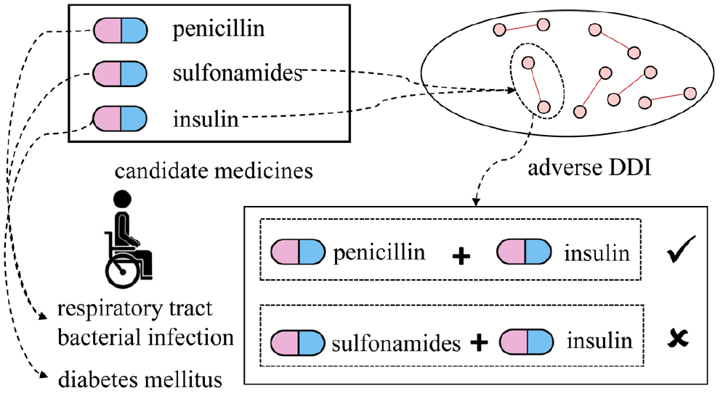
Introduction
6
Problem solving:
The correlations between medicine.
Relation Graph Convolutional Neural Network.
The adverse interactions between medicine.
Drug-Drug Interaction(DDI) knowledge base.

Slide 7
Outline
Introduction
Method
Experiment
Conclusion

Slide 8
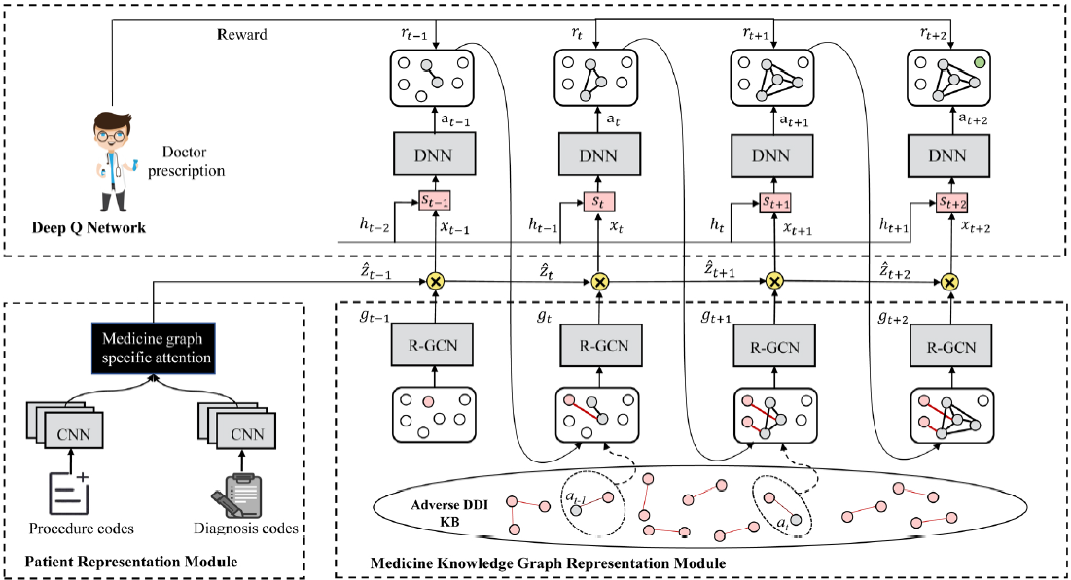
Method
Model over view
END
Output:
3
Input
1
2

Slide 9
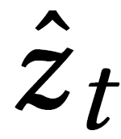
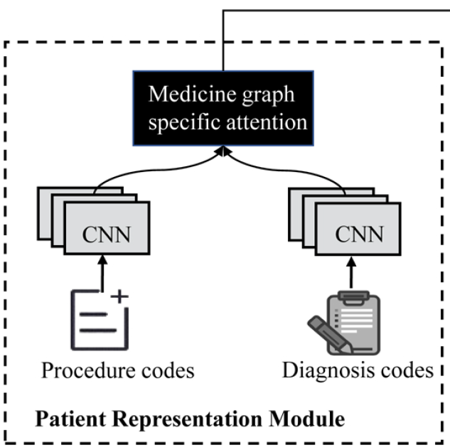
Method
Patient representation module
Patient representation
: { “1125”, “v433”, “v4581” }
Procedure
: {“0066”, “3761”, “3950” }
Diagnosis
: bag-of-word vectors from diagnosis codes
: embedding matrices.
Notes:
Wp、Wd 100維

Slide 10
Method
Patient representation module
Example of converting sequence code into embedding representation :
: { “1125”, “v433”, “v4581” }
Bag-of-word
: { 0,0,….1,…1,…1,….0,0 }
V1
V2
Vn
$$m^{p}$$
…
Notes:
W 為 100維

Slide 11
Method
Patient representation module
Patient representation
The vectors are obtained by flattening matrices V
Attention with Medicine Graph representation, learn the combination of Zd and Zp
Emb
Emb
Notes:
Zp、Zd:100維

Slide 12
Method
Medicine knowledge graph representation module
R-GCN :
Medicine graph representation
: neighbors of node vi according to the relation r.
: set of all relations considered in the graph.
: problem-specific normalization constant.

Slide 13
Method
Medicine knowledge graph representation module
1
2
3
4
5
7
Example of R-GCN :
5
Adj. matrix:
Emb. matrix:
R1:
1 0 0 0 0
0 1 0 0 1
0 0 1 0 0
0 0 0 1 0
0 1 0 0 1
$${Emb}_{1}^{R1}$$
Count the hidden layer of vertex 5
$${Emb}_{2}^{R1}$$
$${Emb}_{3}^{R1}$$
R1: (1/1) *(Wr) * ( ${Emb}_{2}^{R1}$) + (Wo) * (${Emb}_{5}^{R1}$)
$${Emb}_{4}^{R1}$$
+
R2: (1/2) *(Wr) * (${Emb}_{1}^{R2}$+ ${Emb}_{3}^{R2}$) + (Wo) * (${Emb}_{5}^{R2}$)
$${Emb}_{5}^{R1}$$
R2:
1 0 0 0 1
0 1 0 0 0
0 0 1 0 1
0 0 0 1 0
1 0 1 0 1
$h_{5}^{1}$
$${Emb}_{1}^{R2}$$
$${Emb}_{2}^{R2}$$
$${Emb}_{3}^{R2}$$
$${Emb}_{4}^{R2}$$
$${Emb}_{5}^{R2}$$

Slide 14
Method
Medicine knowledge graph representation module
+
Patient representation
R1: (1/1) *(Wr) * ( ${Emb}_{2}^{R1}$) + (Wo) * (${Emb}_{5}^{R1}$)
$h_{5}^{1}$ =
+
R2: (1/2) *(Wr) * (${Emb}_{1}^{R2}$+ ${Emb}_{3}^{R2}$) + (Wo) * (${Emb}_{5}^{R2}$)
Notes:
做了改良 並非加總而是concate

Slide 15
Method
Deep Q Network
Preliminaries
Markov Decision Process :
State :
Set of every possible state .
Action :
Set of every possible action .
Transition :
The transition probability function of state.
Reward :
Reward function.( 1 : predicted is in the answer set , -1: otherwise. )
Discount Factor :
Discount Factor, and .

Slide 16
Method
Deep Q Network
Preliminaries
What is Markov Decision Process ?
terminate
Stage 1
Stage 2
Stage n
Stage n+1
Action 1
……
Action n
$${reward}_{1}$$
$${reward}_{2}$$
$${reward}_{n}$$
$${reward}_{n+1}$$
Terminate when ${Qvalue}_{k}$ == ${Qvalue}_{k+1}$
Q-update :
Best reward of Next state
loss :
Total reward of next state
Total reward of current stage
Notes:
Alpha = 0.0001
Optimize Algo. : Adam

Slide 17
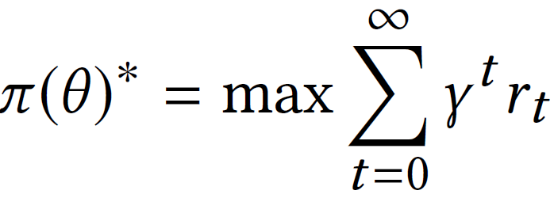
Method
Deep Q Network
Preliminaries
Goal :
learn a policy π(θ) parameterized by θ : maximize the accumulated discounted rewards.
Q-update :
Discount Factor
Learning rate
loss :

Slide 18
Method
Deep Q Network
Notes:
L可以很多層看情況(後面實驗就用3層)

Slide 19
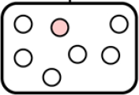
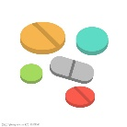
Method
Deep Q Network
$C_{i}^{p}$ + $C_{i}^{d}$ + $g_{1}$ → $Z_{1}$
Simple example :
$Z_{1}$ + $g_{1}$ → $x_{1}$
$Z_{1}$ + $x_{1}$ + $h_{0}$→ $S_{1}$
$C_{i}^{p}$ : { “1125”, “v433”, “v4581” }
Choose the max → action $a_{1}$
$C_{i}^{d}$ : {“0066”, “3761”, “3950” }
Predict Medicine:
M1 | M2 | M3 | M4 | M5
1 | -1 | 1 | -1 | -1
$S_{1}$ :
Gain Reward :
1 0 0 0 0
0 1 0 0 0
0 0 1 0 0
0 0 0 1 0
0 0 0 0 1
$Z_{1}$ + $g_{2}$ → $x_{2}$
$g_{t}$ :
$Z_{2}$ + $x_{2}$ + $h_{1}$→ $S_{2}$
$M_{set}^{ All }$ = $M_{set}^{ All }$ - chosen one ; update $g_{t}$ to $g_{t+1}$
$M_{set}^{ patient i}$: {“$M_{1}$”, “$M_{3}$”}
M2 | M3 | M4 | M5
-1 | 1 | -1 | -1
Choose the max → action $a_{2}$
$S_{2}$ :
$M_{set}^{ All }$: {“$M_{1}$”, “$M_{2}$”, “$M_{3}$”, “$M_{4}$”, “$M_{5}$” }
…
Notes:
h0 is initialized with a zero vector

Slide 20
Outline
Introduction
Method
Experiment
Conclusion

Slide 21
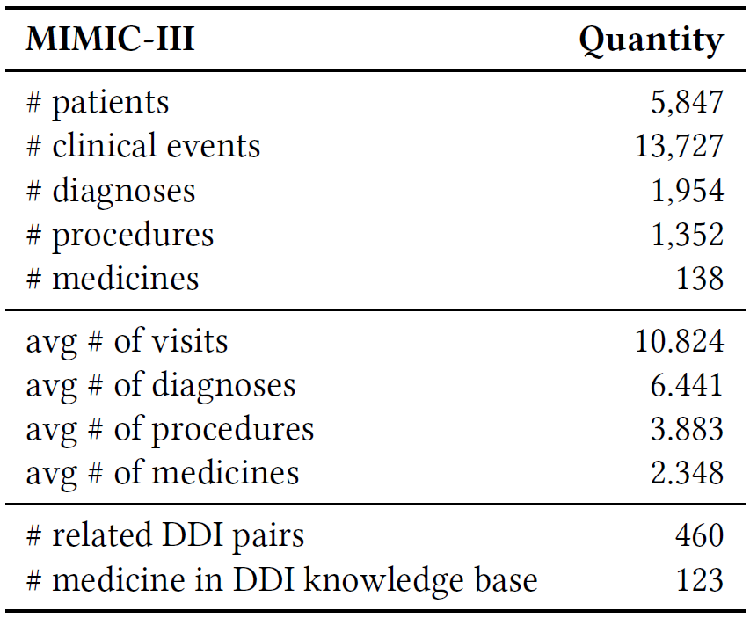
EXPERIMENT
21
Datasets
Notes:
公開的數據集MIMIC-III
醫生在最初24小時內為每位患者開出的藥物
TWOSIDES數據集的DDI知識
排名前40位的嚴重DDI類型

Slide 22
22
EXPERIMENT
Evaluation metrics
: represents all DDI pairs in the DDI knowledge base.
Notes:
Jaccard : 預測 交集 真實情況 / 預測 聯集 真實情況
DDI Rate : 此模型預測出現危險藥物組合的機率。

Slide 23
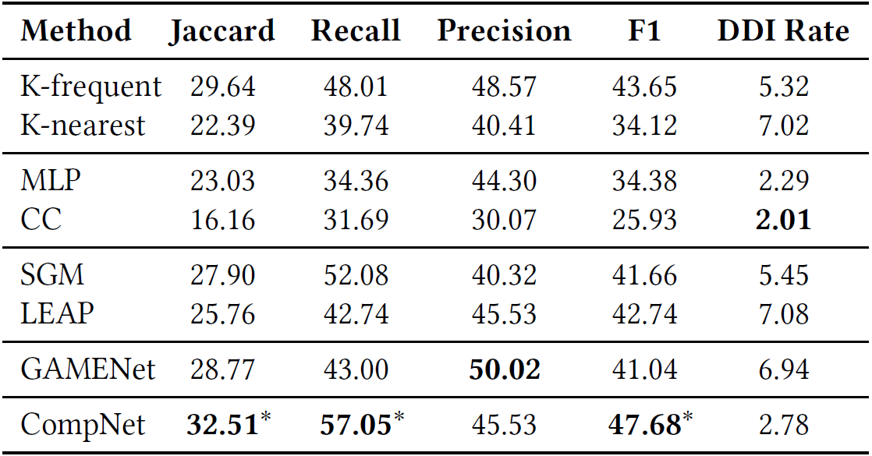
EXPERIMENT
23
RESULTS
Compare with other baseline
Notes:
K-frequent: 計算每種診斷與每種藥物的並發(cooccurring frequency)頻率來預測藥物。 對於每個診斷，它僅選擇排名前K的最常出現的藥物。 我們嘗試將K從1設置為8，最後根據其在驗證集上的性能將K設置為5。
K-nearest : K個最近病患。選擇為pi診斷最相似的患者pj開的藥。 兩名患者之間的相似性通過Jaccard距離進行衡量； 在這裡，我們將K設置為1。
Multi-layer Perceptron (MLP ): 是解決多標籤分類問題的常見方法。 這邊是一個三層感知器的多標籤分類模型。 最後一層使用sigmoid作為激活函數來預測每種藥物的可能性。
Classifier Chain (CC). CC [30] is another commonly used multilabel learning method. We use 3 base classifiers to form a classifier chain to predict medicines and each base classifier is a decision tree [28].
SGM : 將多標籤分類視為序列生成任務，並使用seq2seq模型來預測標籤。 在這裡，我們使用SGM預測藥物組合(利用神經網路取代多個分類器)。
LEAP:將藥物預測問題表述為多實例多標籤學習（MIML）問題。 與SGM類似，它使用遞歸神經網絡（RNN）來預測藥物。 強化學習用於調整參數。
GAMENet : 使用Graph Augmented Memory Module利用GCN將DDI知識圖和EHR圖編碼。 然後，患者的representation以及記憶emb.串聯起來，以預測藥物。
分析 :
好處
CompNet 利用遞迴DQL一步步預測出藥物，這一次的藥物預測是來自上一步的結果，因此能夠很好的得到藥物與藥物之間的相關關係。
CompNet 能夠很好的避免掉藥物的順序關係(order free)，因此訓練時並不會宜並將將不合理的訓續關係學習起來。
CompNet 能夠動態的利用RGCN將不同的關係一併的學好。
輸的地方:
GAMENet 的 precision比ComptNet高4.49%，但GAMENet 的 recal比ComptNet低14.05%，意指GAMENet傾向於預測藥物的正確性，但卻忽略了許多正確的藥物，沒被預測出來。
因為MLP和CC傾向於選擇更少的藥物。 因此，它們的DDI率低於CompNet。

Slide 24
EXPERIMENT
24
RESULTS
Compare with itself
Notes:
No Graph: 測試RGCN的效果，以MLP代替，將藥物選擇投影，並且與病患的representation計算 Zt.
No CMR : 測試沒有考慮藥物的correlative關係，將graph中這個關係的邊拿掉。
No AMR :測試沒有考慮藥物的不良交互作用的關係，將graph中這個關係的邊拿掉，DDI不用。
With COR : 從GAMENet，我們得出藥物的同現關係(co-occurrence)，我們將這種關係也加入medicine knowledge graph，我們從訓練及中獲得這種關係， 如果兩種藥物在HER中同時出現，我們則認定此兩中藥物存在著同現關係。

Slide 25
EXPERIMENT
25
RESULTS
Compare with itself
Notes:
是否每次每次藥物選擇時，是將完整的不良藥物圖讀入，還是只讀入與目前選擇藥物有相關的不良影響藥物。
這表明在每個步驟中引入所有醫學知識將導致預測不良藥物組合的風險更高。 這是因為在每個步驟中，DDI知識庫中的大多數知識都是不相關的，這使得模型很難識別有用的知識。
正如預期的那樣，With All KG的Recall得分要好一些，這意味著我們的自適應醫學知識圖機制也丟失了一些有用的知識。

Slide 26
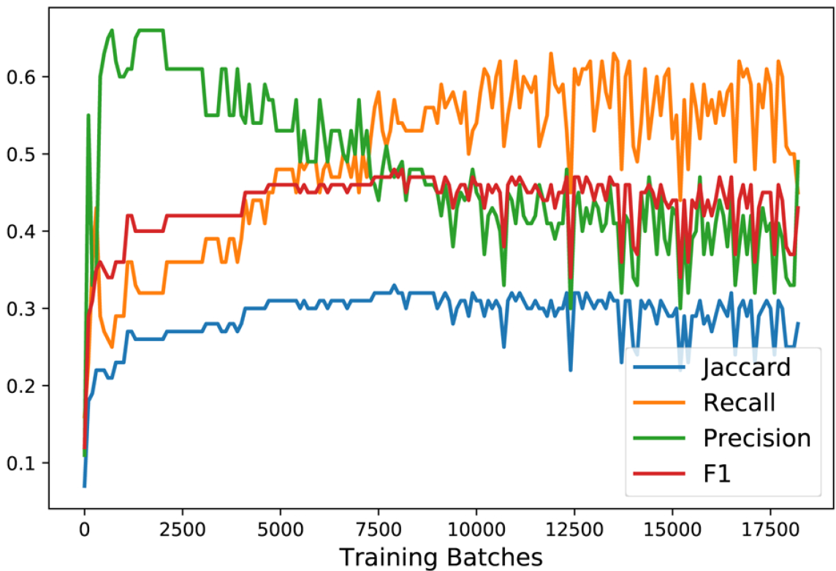
EXPERIMENT
26
Prediction results on different training batches
Notes:
Jaccard，Recall和F1分數總體上呈上升趨勢，但由於DQL的不穩定性而也在波動中[1]。
在訓練過程中，“Precision”值呈下降趨勢。 這是因為Precision對預測的藥物數量很敏感。
例如:
在極端情況下，模型只能為患者預測一種藥物。 即使預測的藥物位於ground truth medicine set，然後Precision達到100％，這也不意味著我們獲得了一個好的模型。 因此，我們應該更加註意Jaccard，Recall和F1值。

Slide 27
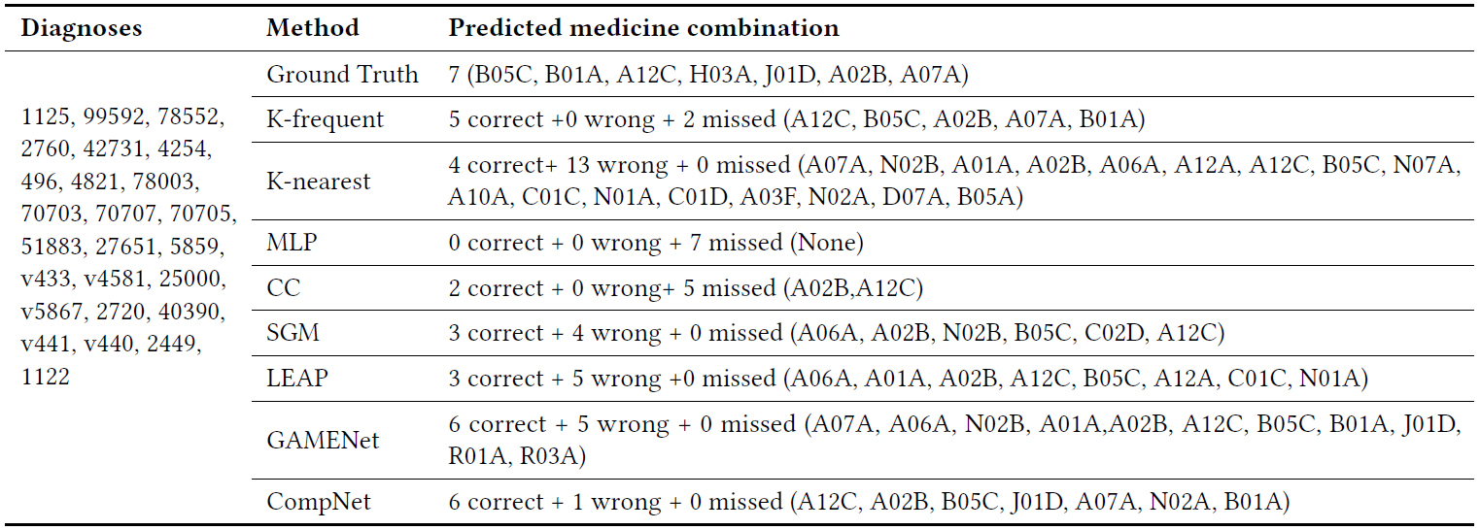
EXPERIMENT
27
Example
w+m
-
2
15
7
5
4
5
5
1

Slide 28
Outline
Introduction
Method
Experiment
Conclusion

Slide 29
Conclusion
We have presented a novel model named CompNet for MCP.
Which can capture useful correlations between medicines while eliminating the unreasonable medicine orders made in previous work.
The results show that CompNet bring improvements and achieving the best performance compared with state-of-the-art methods.
CompNet achieves a much lower DDI ratio than GAMENet in terms of safety.

